Slide 1

MySQL setup step by step and creation MySQL database.
Explanation for the students how install MySQL database.
Lecturer Oksana Dudnik.

Slide 2
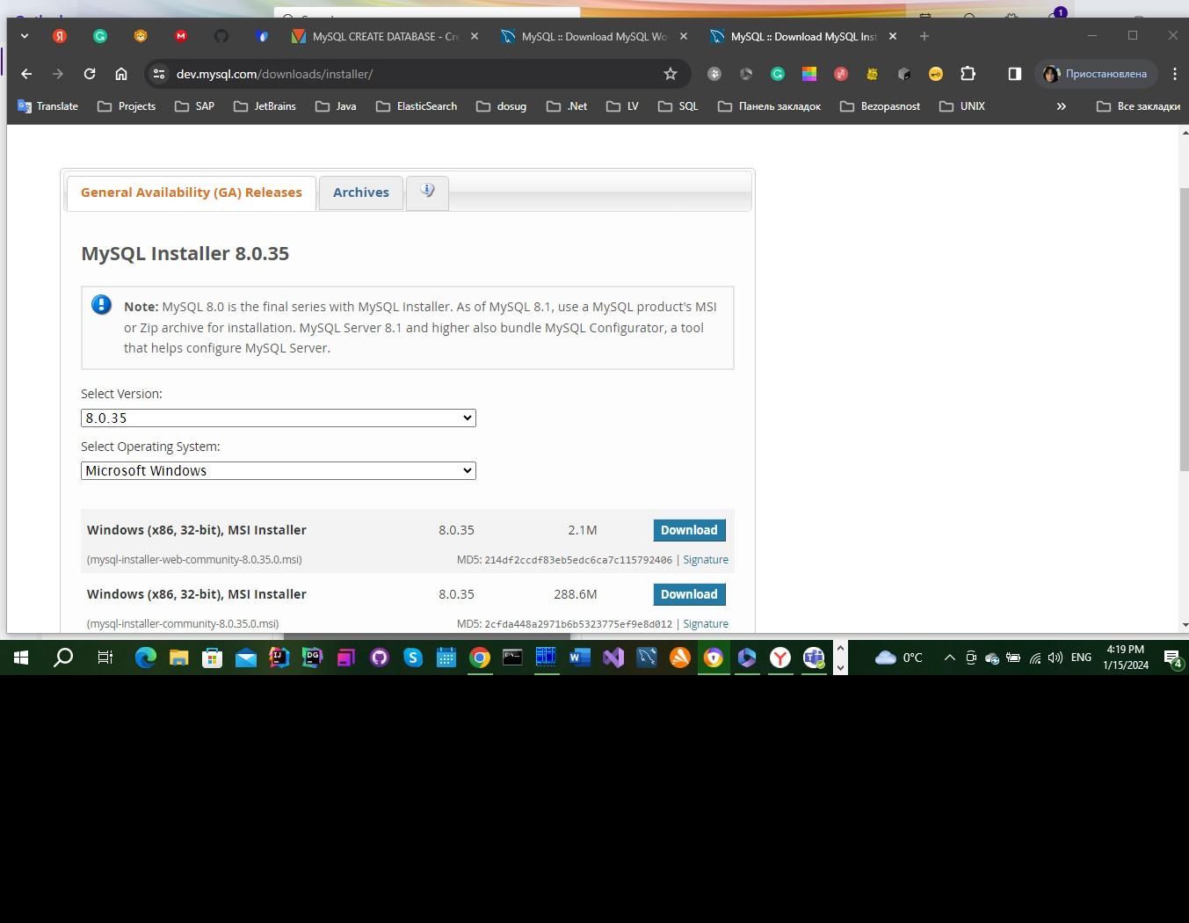
1. MySQL server setup.
Download MySQL for the Windows. Please, use link:
https://dev.mysql.com/downloads/installer/

Slide 3
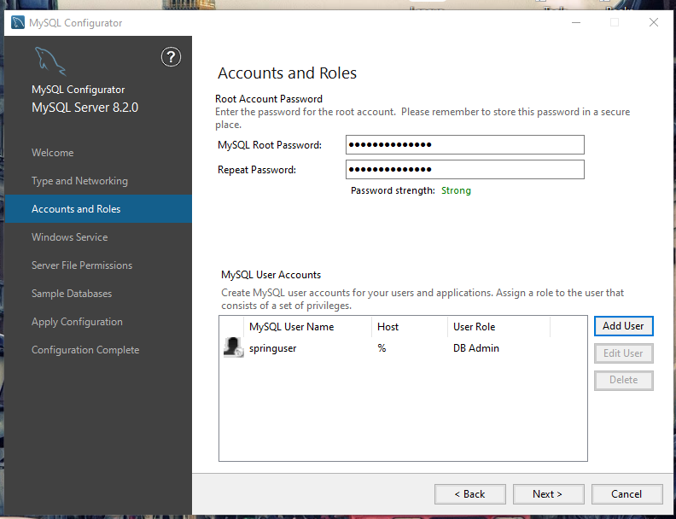
2. Adding specific user ‘springuser’.

Slide 4
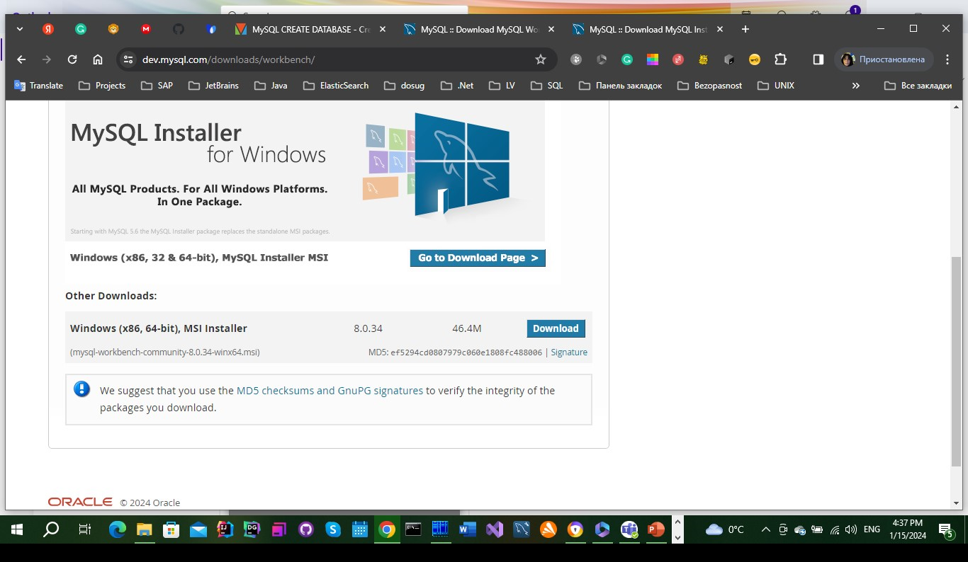
3. MySQL Workbench setup.
Please download MySQL Workbench:
https://dev.mysql.com/downloads/workbench/

Slide 5
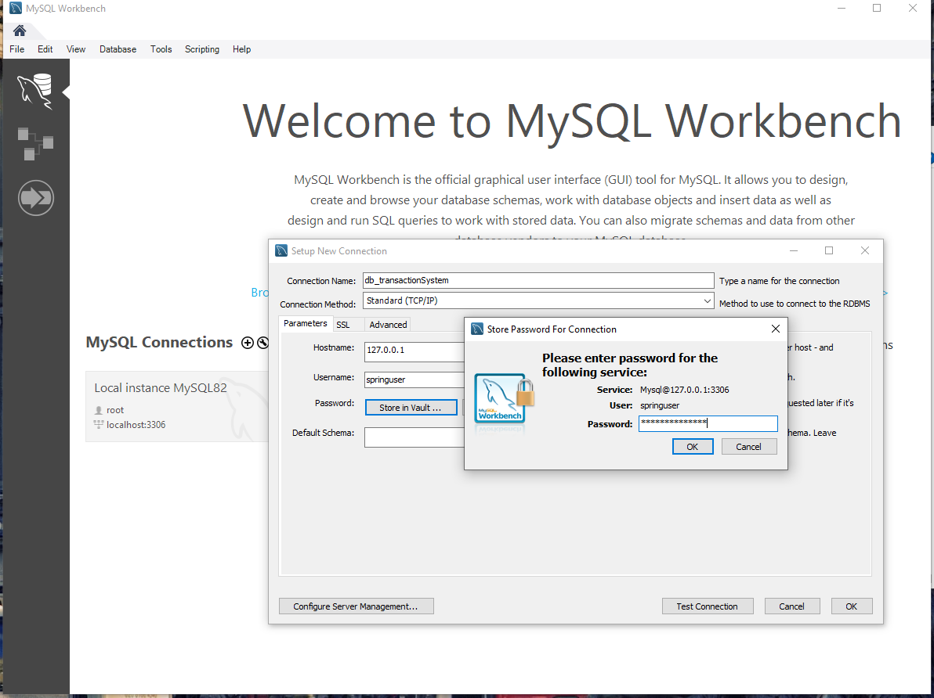
4. Creating connection with WorkBench.

Slide 6
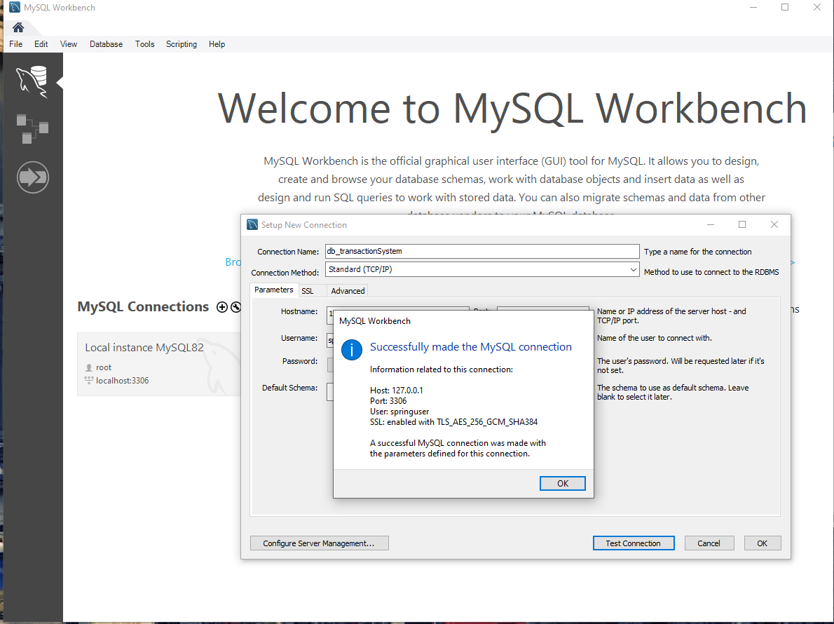
5c. Creating database in the IntelliJ Idea.

Slide 7
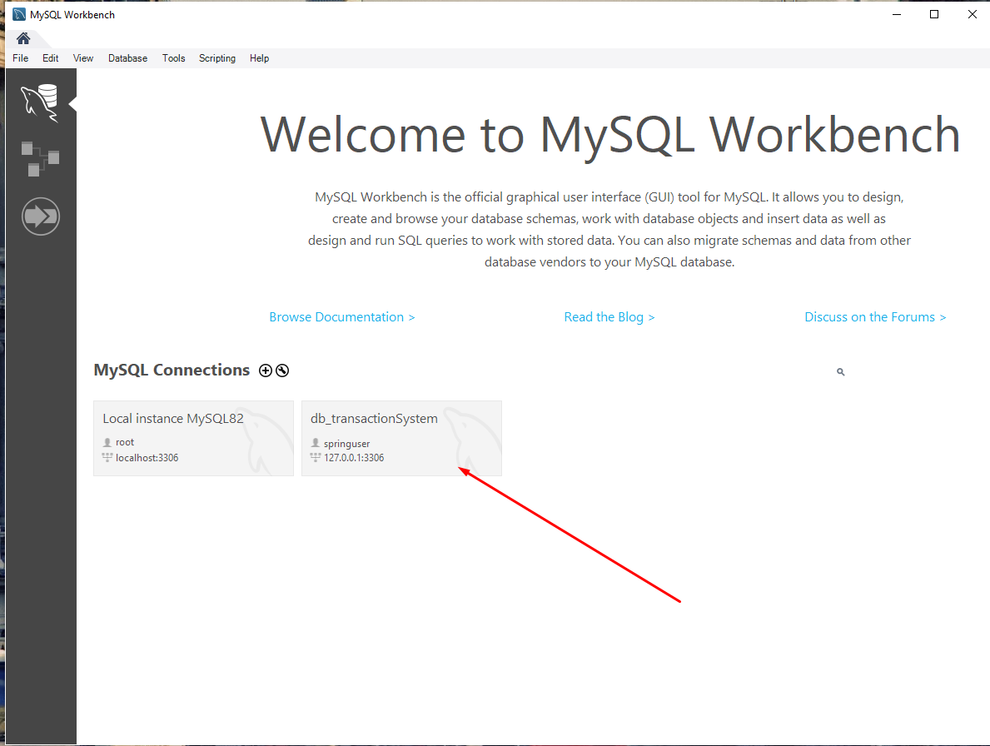
5c. Creating database in the IntelliJ Idea.

Slide 8
5. Create user root with password.
=mysql.exe –u root –p
And input password which you gave in the server settings.
It’ll prompt you to enter a password. To authenticate, you need to type the password for the root user account and press the Enter key:
Enter password: ********
Next, display the databases available on the server using the SHOW DATABASES statement. This step is optional.
SHOW DATABASES;

Slide 9
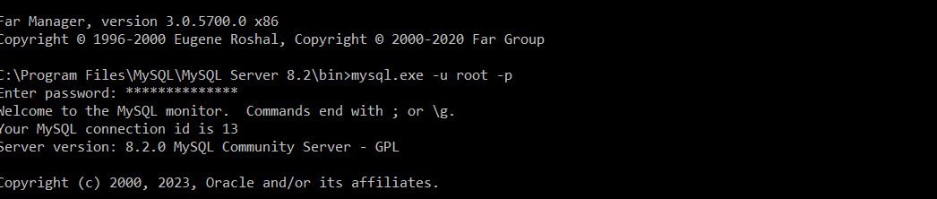
Input password for the user root:

Slide 10
4. Creating a new database using the MySQL client tool. https://www.mysqltutorial.org/mysql-basics/mysql-create-database/
To create a new database in MySQL, you use the CREATE DATABASE statement. The following illustrates the basic syntax of the CREATE DATABASE statement:
CREATE DATABASE [IF NOT EXISTS] database_name
[CHARACTER SET charset_name]
[COLLATE collation_name];
First, specify the name of the database after the CREATE DATABASE keywords. The database name must be unique within a MySQL server instance. If you attempt to create a database with a name that already exists, MySQL will issue an error.
Second, use the IF NOT EXISTS option to conditionally create a database if it doesn’t exist.
Third, specify the character set and collation for the new database. If you skip the CHARACTER SET and COLLATE clauses, MySQL will use the default character set and collation for the new database.
It’ll return the following:
Query OK, 1 row affected (0.02 sec)

Slide 11
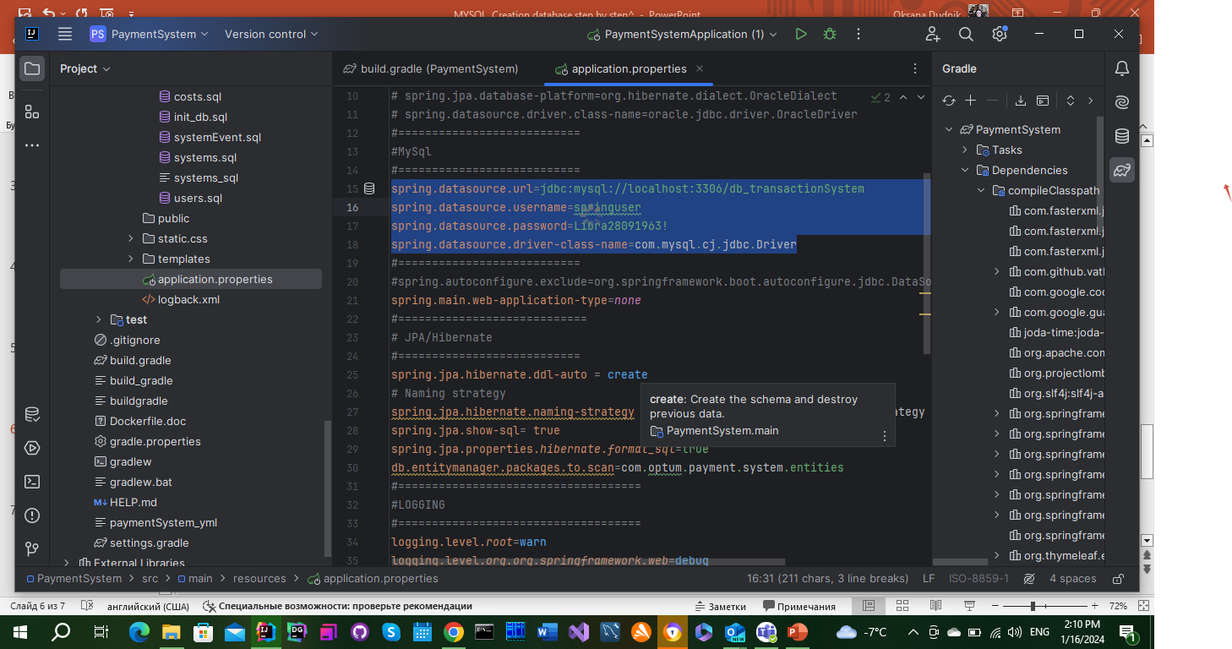
5. Creating database in the IntelliJ Idea
We have created database for example with such attributes:

Slide 12
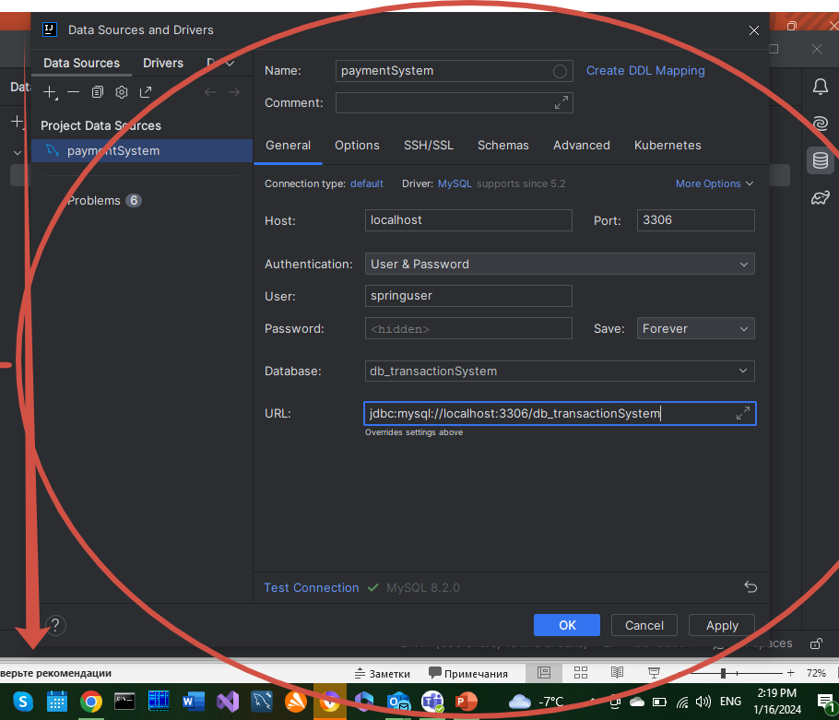
5a. Creating database in the IntelliJ Idea.

Slide 13
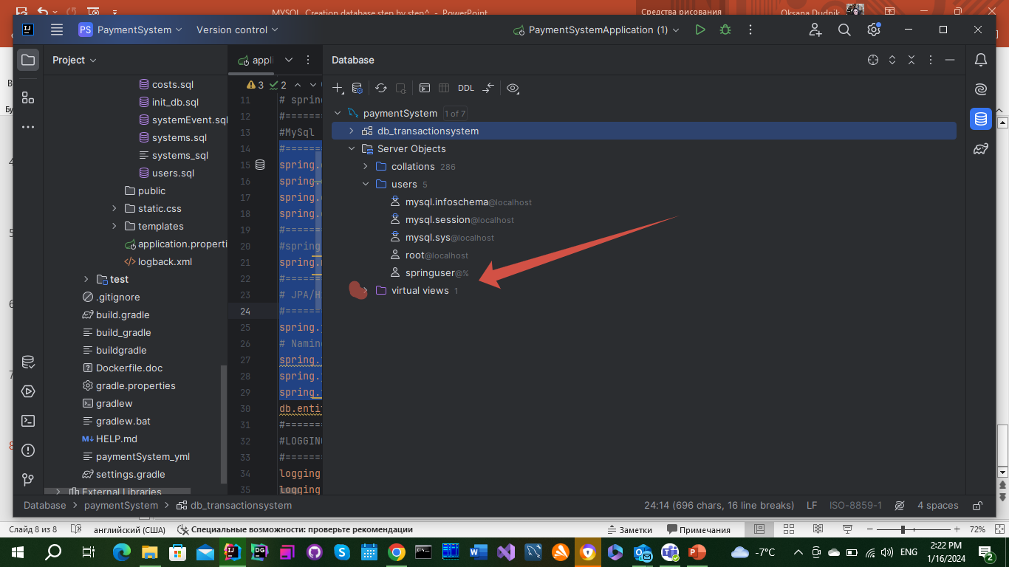
5b. Creating database in the IntelliJ Idea.

